Slide 1
LoReNa
Locator, Research & Naming System for a Coordination Middleware

Slide 2
Introduction
LoReNa: Locator. Resource & Naming
The thesis aims at developing a model and architecture for the Naming System of the TuCSoN Coordination Middleware, including agents, nodes, and resources.
Universal identities accounting for both physical and virtual mobility will be defined, moving towards a comprehensive, distributed Management System dealing also with ACC and transducers
Foreseeing issues such as fault tolerance, persistence, consistency, along with disembodied coordination in the cloud.

Slide 3
Background Knowledge
TuCSoN
TuCSoN (Tuple Centres Spread over the Network) is a coordination middleware that allows the communication and coordination between agents by making use of tuple centres, which are defined as programmable Tuple spaces in which the Agents can enter, read or consume tuples.
Cassandra
Cassandra is a non-relational database management system optimized for handling large amounts of data that can work in a distributed management system maintaining all its features
JADE
JADE (Java Agent DEvelopment Framework) is a Java-based framework to develop agent-based applications for interoperable, intelligent, multi-agent systems.

Slide 4
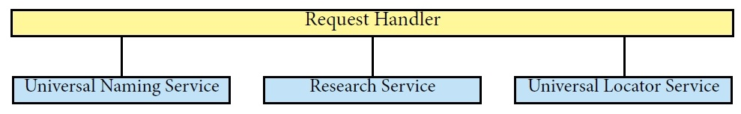
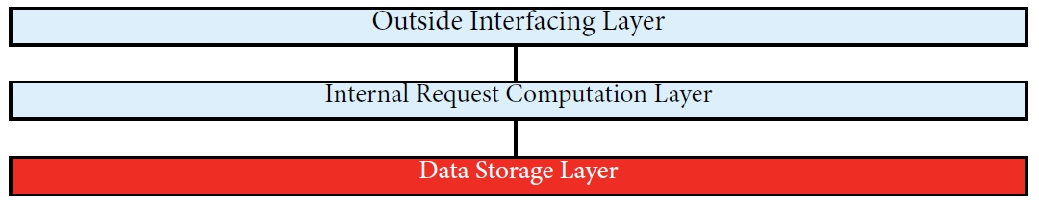
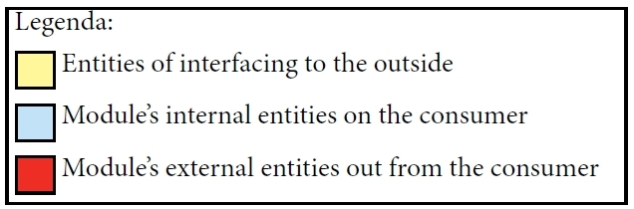
LoReNa
Structure & Interaction Model
LoReNa - Main Model
LoReNa – Internal Main Model

Slide 5
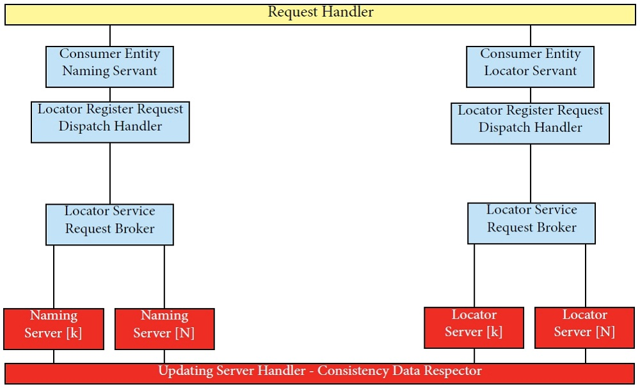
LoReNa
Universal Naming & Locator Services
Structure & Interaction Model

Slide 6
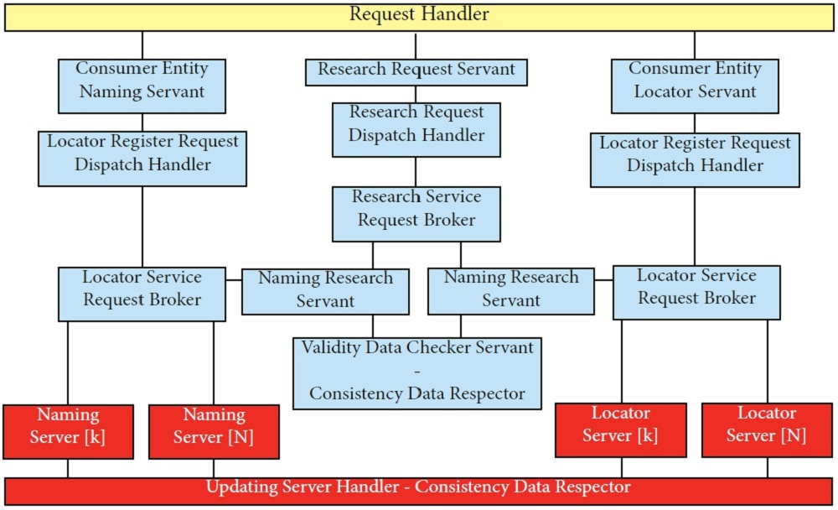
LoReNa
Universal Naming & Locator Services
Structure & Interaction Model

Slide 7
Future Developments
Individual Tuple Space
This development allows to each active entity (agents) to communicate directly with another one without a central Tuple Space, so all entities will have an Individual Tuple Space. Then, this development provides a new communication type for the active entities (agents) and it is like the message passing.
Customized Query Language
With this type of query language it's possible to increase the efficiency and decrease the response time of all operations that the entities make on the database. This improvement is given by a fundamental factor : if there is an ad-hoc query language, all requests can be less complex because the data store system needs only to receive the data and the operation type (for example update, replace, etc.) without any other overhead data.

Slide 8
Conclusions
Compatibility with any middleware by changing the specific servant entities
Fully modularized in order to allow the network distribution through its layered structure
It can be implemented in many programming languages
It is a complete, dynamic and extendible module that can be improved by the described future developments

Slide 9
Thanks for Your attention

